Slide 1

Roundabout Vs Traffic Light Intersection Traffic Flow Optimization
Team: SUMO Traffic Simulation
Matthew Blank - mb68@hood.edu
Alain Shekanino - ams49@hood.edu
Dylan Blevins - deb9@hood.edu
May 8th, 2020

Slide 2
The Project
Description: ​
In our project, we developed simulations that compare roundabout and a traffic light regulated intersection and their effectiveness at redirecting traffic at a four-way junction.
Objectives:​
Determine a which method is more effective at redirecting traffic
Determine optimizations for faults found in original data analysis
Notes:
1. We look to determine a more effective methods at redirecting traffic between the roundabout and the traffic light controlled intersection.
2. Determine necessary optimizations for any fault we find in the original data analysis

Slide 3
Background
According to Federal Highway Administration:​ [1]
New road are being constructed​
Existing roads being modified​
Roundabout:
Yield sign vs Red-Green light
Vehicles are constantly in traffic circulation
​The Myth-Busters [4]
4 way stop and a roundabout
Notes:
While several studies have shown that roundabouts can improve safety and operational performance compared to traffic lights, there is little being done to take an existing traffic light control at a given intersection and convert it into a roundabout. And then determine a faster travel time in terms of average wait time at the intersection.
--There have been many other research papers and models done especially by the National Highway Traffic Safety Association.
According to According to Federal Highway Administration:​
New construction of roads and modifications of roads.
Roundabout
Yield sign keeps traffic flowing
BUT there is no data that talk about the average wait time for roundabout or traffic light
--the myth-busters compare the effectiveness of a 4 way stop and a roundabout by using guide rails and people to assign directions for the stop and people to count the vehicles that passed through.
They found a roundabout to have a less average wait time. BUT the results can be skewed due to human error. Moreover the didn’t use traffic lights.
Crashes: 75%​
Pedestrian Collisions: 40%​
Fatality Collisions: 90%​
Overall collisions: 37% ​
New roads are being developed and existing road being modified.

Slide 4
Project Plan
Gather pre-existing traffic data​
Two simulations in SUMO
Four-way traffic control ​
Round-a-bout​
​Analyze Results
Draw Conclusions
Notes:
*we will use Data from pre-existing intersection at YanceyVille & Lees Chapel Rd (NC)
*This data Will be gathered from Georgia Department of transportation webite
-- We plan to create 2 simulation in SUMO of four way intersection traffic control and a roundabout (both running using the pre-existing traffic data)
&& Finally, We will analize our results from both the round about and the four way intersection traffic control
--To come up with a conclusion of our research.

Slide 5
Expected Data
Avg # of cars at given lane​
Avg wait time at a junction
Max # of cars at given lane
Avg trip duration for all vehicles

Slide 6
Technical Description
Simulations construction tools
NetEdit – click and place simulation editing interface that allows users to manipulate .xml files
.xml files: Manipulate the SUMO environment through code
SUMO GUI : an environment to initiate the simulation
Java & Python
Excel : data tables and calulations
We have 570 lines of code in this project
Half a GB in data
Features
Output
Notes:
NetEdit: Visual manipulation of routes, intersection
.xml files: Ex: A program that spawn 20,000 vehicles
SUMO GUI: With controls such Play, pause, step forward
Java & Python: used to speed up data parsing. Python create flow data and extract information from excel.
Features: trafficlights, vehicles, pause button.
Output: lane length, queuing time, trip duration

Slide 7
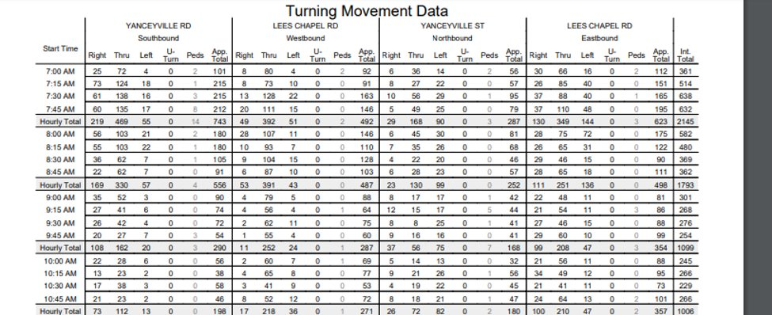
Data

Slide 8


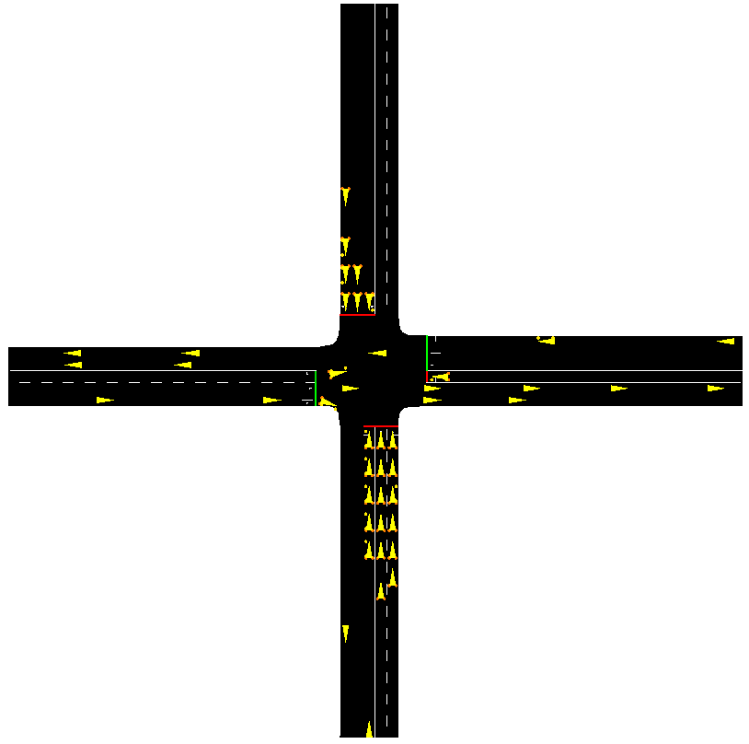

Status: 4-way Traffic light
Notes:
The yellow triangles are the vehicles
The red and green line represent the traffic lights

Slide 9
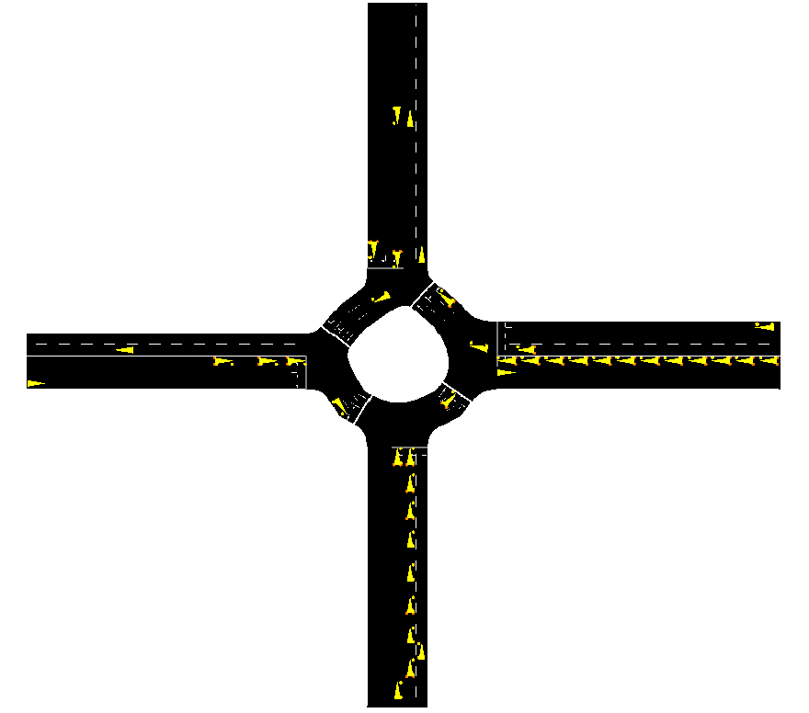
Status: Standard Roundabout

Slide 10
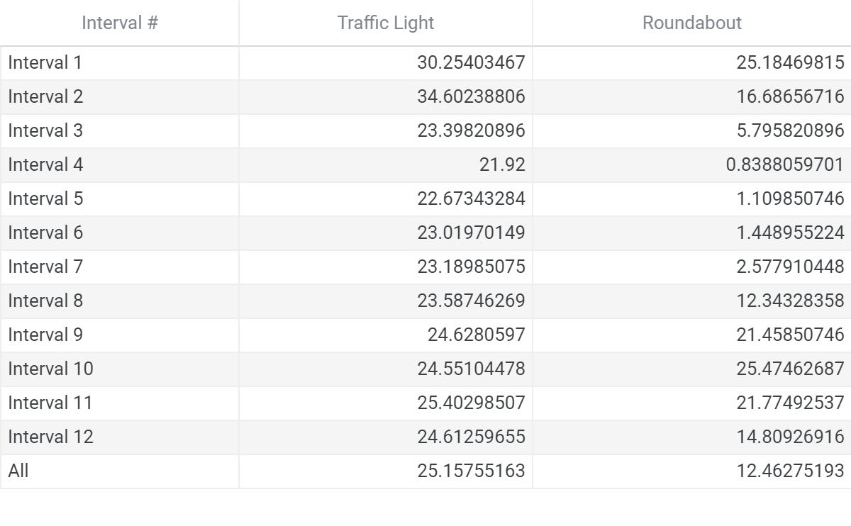
Results

Slide 11
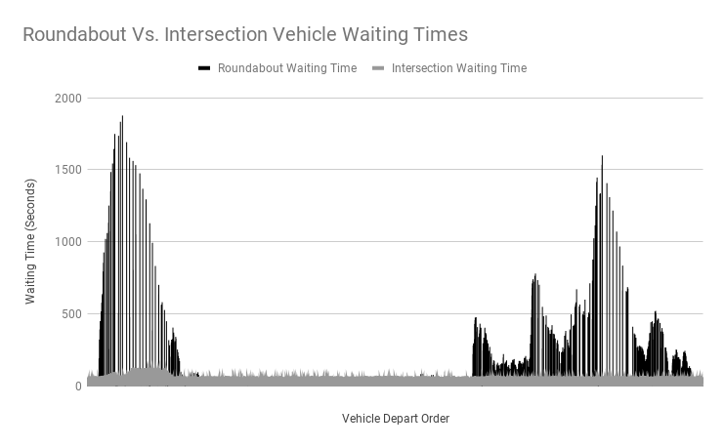
Results

Slide 12
Status: Standard Roundabout

Slide 13
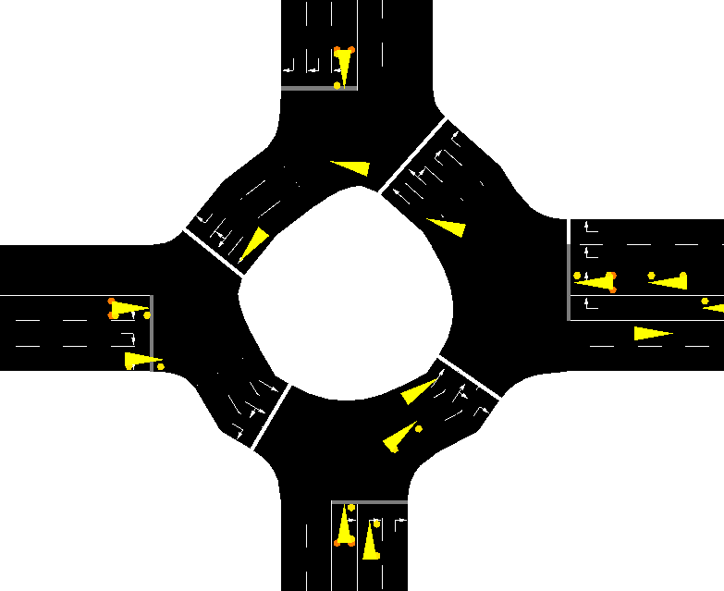
Status: Extended Lane Roundabout

Slide 14
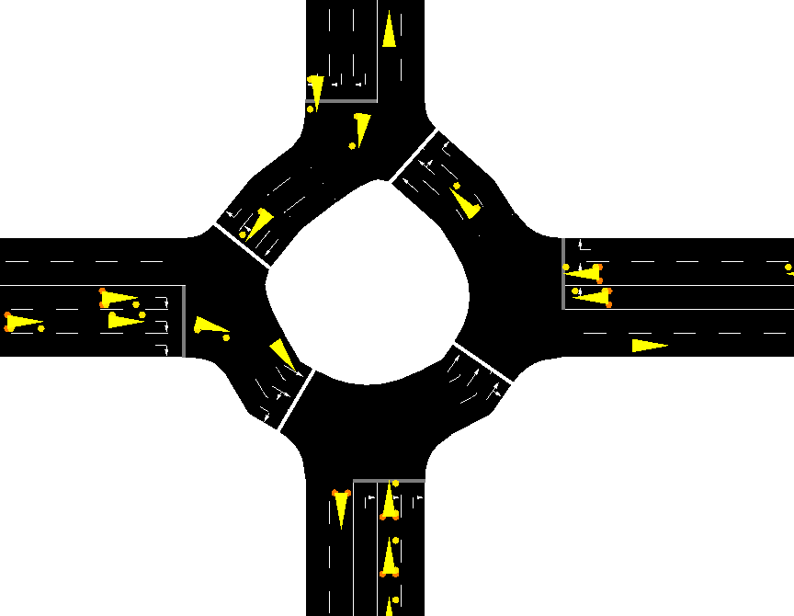
Status: Reduced Lane Roundabout

Slide 15
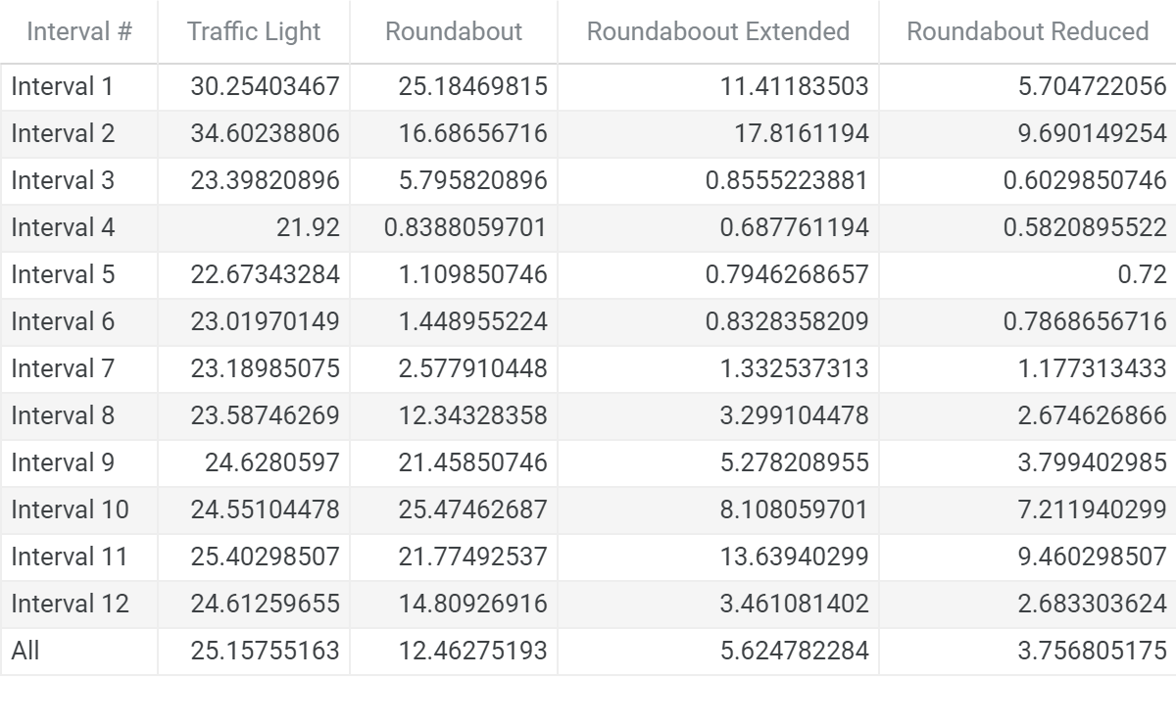
Results

Slide 16
Accomplished Work
Accomplished Work:
We have produced the intersection and collected the data for it
We have produced 3 roundabouts and collected the data for them.
We have compared the data
We have complied our report and findings
Notes:
We have finished creating our intersection and original roundabout.
We then ran the trails and collected data, from these results we created two more roundabouts one with an extended lane and one with a reduced lane.
We collected data for the two new roundabouts.

Slide 17
Lessons Learned
What Went Right:
Data Gathering -> Simulation production -> Data Analysis – Almost all tasks were completed without any alterations from our plan
What Went Wrong:
Few progression challenges that we ultimately overcame
Lane Construction
Data Production
Java > Python for large data sizes.
What we would do differently:
Complexity
Simplicity
Notes:
Complexity – not adding unneeded complexity (Unusual intersection shape) created these "hiccups" that slowed progression
Simplicity - using a simpler design, since this is our first using SUMO,

Slide 18
Future Work
Add surrounding roads to simulations
Add different kinds of vehicles
Be able to get data on other roads to see their impact on area tested and that area’s impact on other roads.
Retest intersection after adding extra lane.
Retest with different high traffic flow rates and low traffic flow rates.

Slide 19
References
[1] “Roundabout benefits,” WSDOT, 14-Sep-2018. [Online]. Available: https://www.wsdot.wa.gov/Safety/roundabouts/benefits.htm. [Accessed: 28-Jan-2020].​
​
[2] ACS Engineers, “Roundabouts vs Traffic Lights,” ACS Engineers, 22-Aug-2016. [Online]. Available: https://www.acsengineers.com.au/2016/08/22/roundabouts-vs-traffic-lights/. [Accessed: 28-Jan-2020].​
​
[3]“Intersection Safety - Safety: Federal Highway Administration,” Safety. [Online]. Available: https://safety.fhwa.dot.gov/intersection/innovative/roundabouts/. [Accessed: 28-Jan-2020].
[4] Wimp.com. 2017. Mythbusters: Four-Way Stop Vs. Roundabout.. [online] Available at: <https://www.wimp.com/mythbusters-four-way-stop-vs-roundabout/> [Accessed 7 May 2020].

